Slide 1

Viva Voce
Minor Project-2 Summer Semester-2024-25
Department of Electronics and Communication Engineering
Title: Automated Weather Monitoring Station Using Embedded System
Domain: Embedded
Date: 30-10-2024
Project Team Members
VTU21198(P. Surya)
VTU21179(B. Manikanta)
VTU21225(S. Durga Srinivas Prasad)
Supervisor: Dr. Sathesh. M
(Assistant Professor)
Dept. of ECE

Slide 2
Content
Second Review comments and Response
Components Required
Block Diagram
Literature Survey
Flow chart
Proposed methodology
Time line
Results and Discussion
output
Conclusion
References

Slide 3
Second Review comments and Response
Comment:- Work to be carried out.
Response:- we have collected the all the components and examine all of them by connecting them
Comment:- Developing the code
Response:- We developed the code that integrates with hardware components & to give accurate results

Slide 4
Components required
Hardware components:-
- NodemcuESP8226
- DHT11 sensor
- BMP180 sensor
- Rain sensor
- Jumper wires
- Breadboard
. Software required:-
- Arduino IDE software

Slide 5
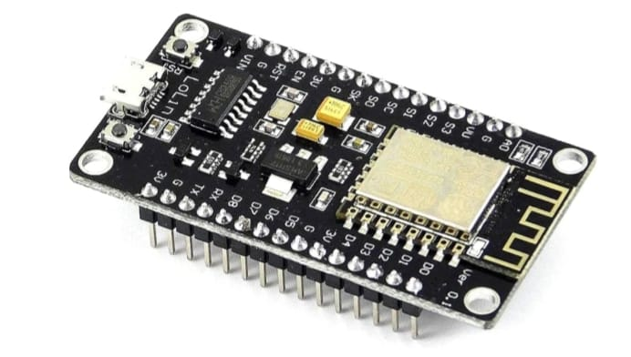
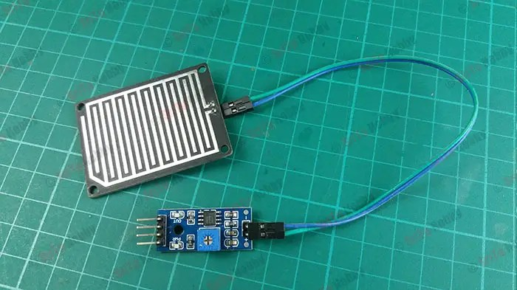
Node MCU board
Rain sensor

Slide 6
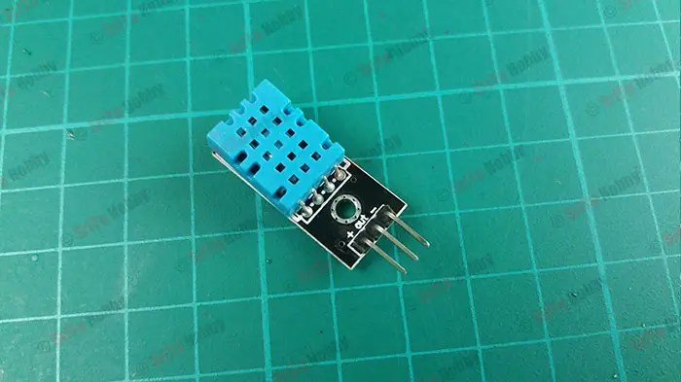
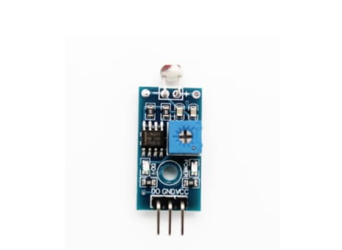
DTH11 Sensor
LDR sensor

Slide 7
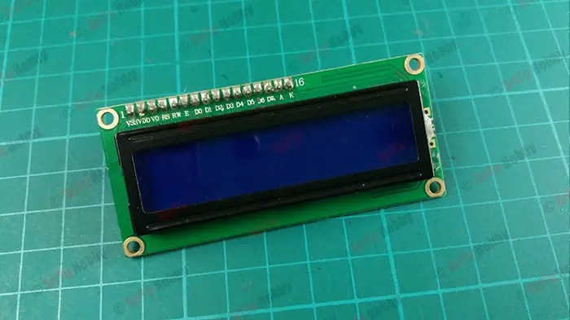
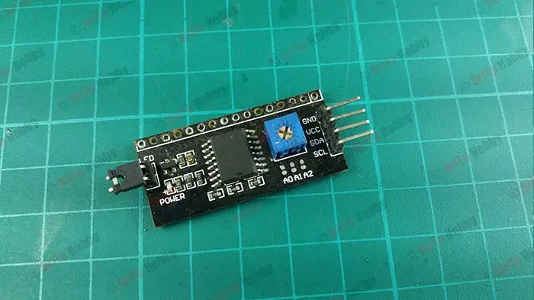
LCD display
I2C module

Slide 8
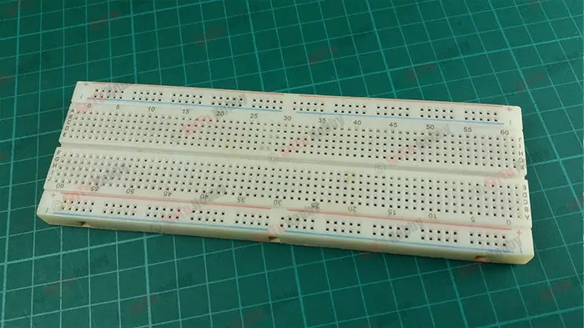
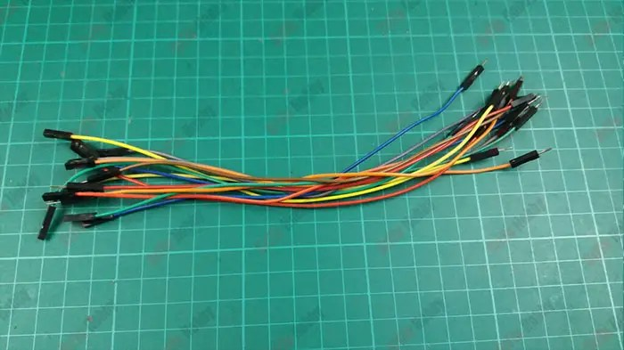
Bread Board
Connecting wires

Slide 9
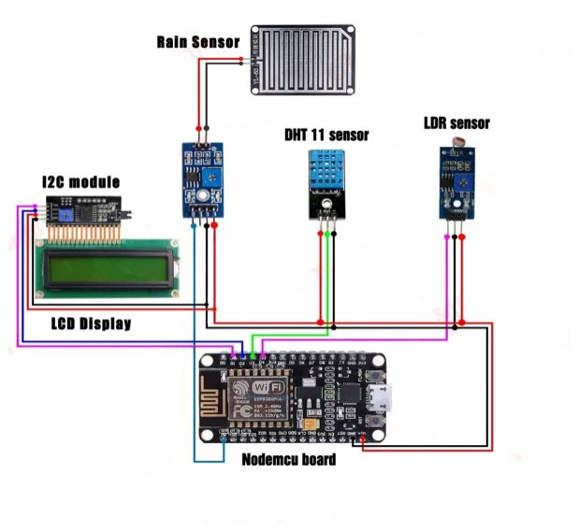
Block diagram

Slide 10
LITERATURE SURVEY
Sl no. | Author | Title | Journal with year | study | Inference
1 | Krishna murthi | Autonomous based weather monitoring system. | International journal of engineering research-2021. | Weather monitoring Using embedded. | Autonomousweather monitoring system provided real time accurate data.
2 | P. Sushmitha | Design & implementation of weather monitoring. | International journal of computer applications-2019. | Observing the weather changing with respect to climate. | The design & implementation of a weather monitoring & controlling system.
3 | Dr. k. Srinivas rao | Research on weather monitoring system | International journal of advanced research & communication | Analysis & monitoring of change in climate or weather with respect to time | Research on weather monitoring system of climate change

Slide 11
Sl.no | Authors | Title | journal details with year | study | inference
4 | John garfinkel | New year stratosphere sudden warning & it’s real time prediction. | Journal of geophysical research-2019. | To study the changes in weather. | To analyze the changes in weather.
5 | Karthik.k | Arduino based models weather monitoring system. | International journey of engineering-2015 | To monitor the continuous change in weather. | Getting updated about weather can give accurate results.
6 | G. Tiwari | Humidity control system. | Journal of climatic change -2015. | To know how much amount of humidity present | By observing humidity we can estimate change in weather

Slide 12
Sl no. | Author | Title | Journal details with year | Study | Inference
7. | P.Russo | Monitoring weather conditions through smart phones | Journal of network&computer applications 2017. | Study the weather conditions through technology | by using technology we can be update about changes in weather conditions
8. | Catsouli.j | Designing embedded hardware | Journal for designing embedded systems 2016 | By using embedded we can track weather conditions | Embedded technology helps us to keep the device stay connected
9. | Yalagi.p,s | Smart home automation | International journal of computer applications 2016 | To study the home automation | Home automation can also used in weather monitoring

Slide 13
Proposed Methodology
1. Hardware Setup:
Select sensors (temperature, humidity, pressure, rain, etc.) based on requirements.
Connect sensors to NodeMCU using appropriate pins.
Power the system (battery, solar, AC adapter).
2. Software Development:
Write code to read sensor values.
Implement Wi-Fi connectivity using Nodemcu ESP8266.
3.Monitoring and Maintenance:
Regularly check system performance and data quality.
Update software and firmware as needed.
Troubleshoot issues and perform maintenance.

Slide 14
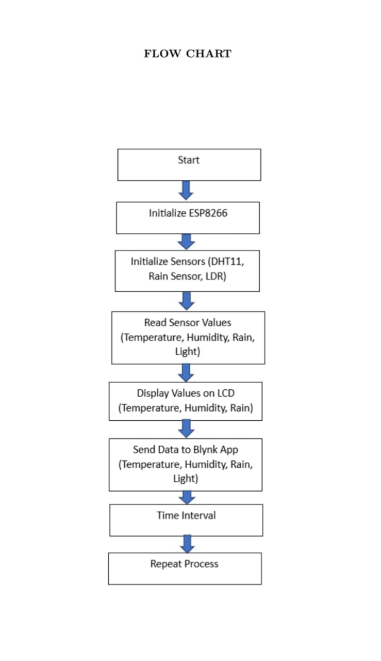

Slide 15
Timeline
Week | WORK
1 | Acquiring the necessary components.
2 | Inspecting the components
3 | Integrating the hardware components
4 | Developing the code and dumping into hardware system
5 | Checking the connections
6 | Integrating the hardware with checking weather conditions
7 | Publishing the paper

Slide 16
Results and Discussion
Result
The weather monitoring station built using NodeMCU successfully measured and transmitted environmental data (temperature, humidity, and pressure) in real time. The system demonstrated the following performance:
Real-Time Monitoring:
Users were able to access and visualize the data remotely through mobile or web interfaces.
Local data display options (such as an OLED screen) also worked reliably for on-site monitoring.
Discussion
The Node MCU-based weather monitoring station showed great promise as a cost-effective and efficient solution for real-time environmental monitoring. Here are key points of discussion:
Reliability and Connectivity:
NodeMCU’s Wi-Fi capabilities were sufficient for steady data transmission. In a few cases, connectivity dropped due to network instability, but the system automatically reconnected without user intervention. This auto-reconnection feature added robustness to the setup.

Slide 17
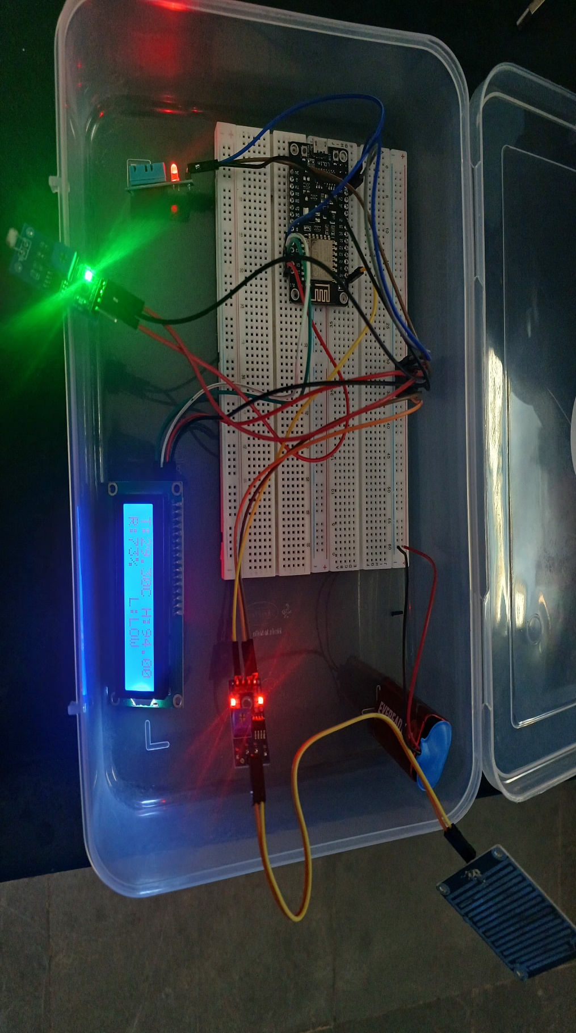
OUTPUT

Slide 18
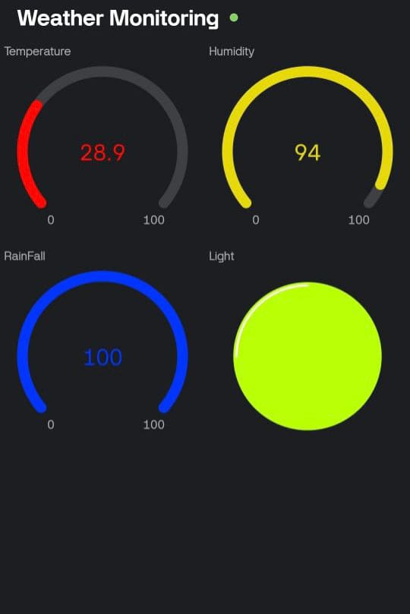
MONITORING THROUGH WEBSITE

Slide 19
Conclusions
The automated weather monitoring station designed with ESP8266, DHT11, LDR sensor, rain sensor, and LCD with I2C provides a cost-effective, scalable, and efficient solution for real-time environmental monitoring. By leveraging embedded systems and IoT capabilities, the project demonstrates how multiple environmental parameters like temperature, humidity, light intensity, and rainfall can be measured, analyzed, and monitored effectively. The integration with the Blink platform enhances the usability of the system by enabling remote access through a smartphone. This feature allows users to visualize data on dashboards or receive alerts via mobile apps, ensuring continuous awareness of environmental conditions from any where with internet connectivity. Additionally, the LCD module with I2C facilitates on-site monitoring, making the system suitable for areas where continuous mobile connectivity may be limited. Further-more, trend analysis over time using stored weather data can support predictive models, leading to better forecasting and decision-making. This project demonstrates how IoT enabled solutions can transform traditional weather monitoring systems into smart, connected systems. With future upgrades—such as using additional sensors

Slide 20
References
Rao, John Garfinkel, Cristiana Chen, Holland White, I.P. (2019): The 2019 new year stratosphere sudden warming and its real‐time predictions in multiple S2S models. – Journal of Geophysical Research.
A. Sharma, G. Tiwari, and D. Singh, “Low cost Solution for Temperature and Humidity monitoring and control System using Touch Screen Technology,” vol. 2, no. 1, pp. 10–14, 2021.
Karthik, K. Suraj, T.Lokesh & Arun, P. (2015). Arduino Based Weather Monitoring System. International Journal of Engineering Research and General Science, Volume 3, Issue 2, March-April, 2015, pp. 452-458. M. Young, The Technical Writer’s Handbook. Mill Valley, CA: University Science, .

Slide 21
References
Aloi, G., Caliciuri, G., Fortino, G., Gravina, R, Pace, P, Russo, W., Savaglio, C. (2017): Enabling IoT interoperability through opportunistic smartphone-based mobile gateways. – Journal of Network and Computer Applications 81: 74-84.
Catsoulis, J. (2005): Designing Embedded Hardware: Create New Computers and Devices. – O'Reilly Media, Inc. 398p
Gunge, V.S., Yalagi, P.S. (2016): Smart home automation: a literature review. – International Journal of Computer Applications 10p.

Slide 22


